Slide 1
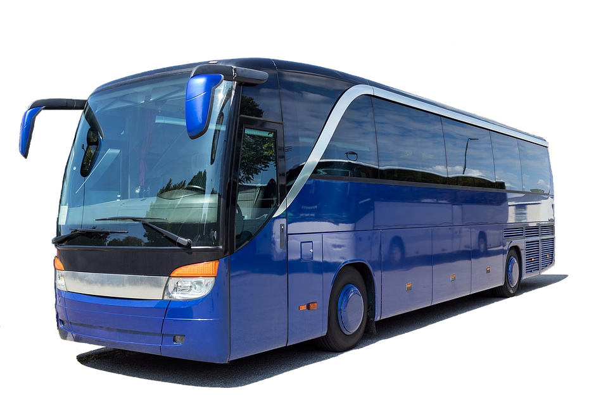
Bus reservation system

Slide 2
PROGRAMMING FUNDAMENTALS SEMESTER PROJECT
PROFESSOR :
PROF. KHAWAR IQBAL
PRESENTERS :
TAHREEM MEHMOOD (49140)
ALEEZA NADEEM (48718)
MINAHIL SHREEF (49004)

Slide 3
INTRODUCTION
A bus reservation system is a mobile or web software solution designed to provide customers with a personalized easy-to-utilize user experience for booking and purchasing tickets online.
It stores customers' personal data records, scheduled routes, frequent trips, drop points, and other information.

Slide 4
Features in project
⦁ LOGIN
⦁ ROUTES OF THE BUS
⦁ SEATS
⦁ DETAILS
⦁ INSTRUCTIONS
⦁ PAYMENT VOUCHER
⦁ LOG OUT

Slide 5
MATERIAL USED
ARRAY
LOOPS
FILE HANDLING
CLEAR SCREEN
IF ELSE
FUNCTIONS
OPERATORS
COMPILER
DEV C++
LANGUAGE
C++

Slide 6
FLOWCHA\RT
LOGIN
Routes
Bus details
Seats reservation
Challan
Generation
Logout

Slide 7
CONCLUSION
BETTER WORK EFFICIENCY
SECURITY
ACCURACY
RELIABILITY
FEASIBILITY
NO SOURCE CODE USE

Slide 8
thankyou

